Slide 1
Mafia Prototype
(click to begin)

Slide 2
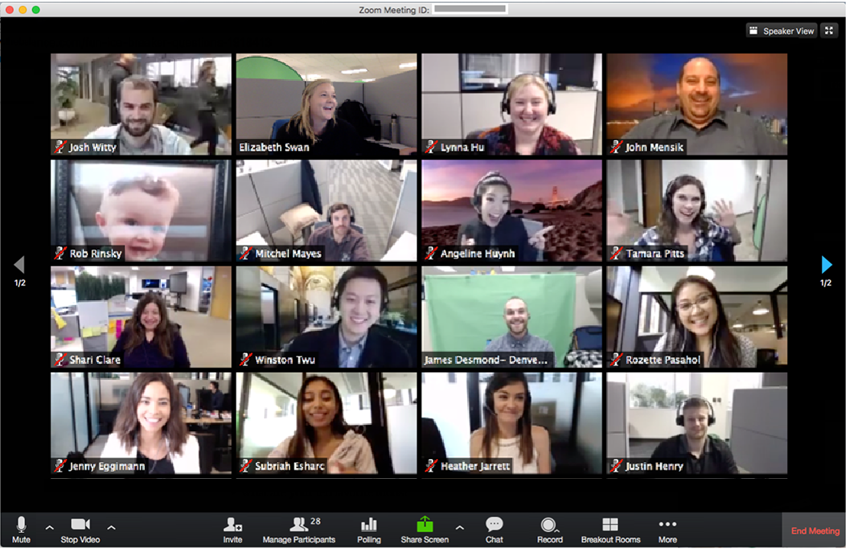


Slide 3
Host a game of Mafia?
Yes No
X

Slide 4
Mafia
Welcome to Mafia!
In this game, players are assigned a secret identity – either a Mafia member or an innocent civilian.
For civilians, the goal is to eliminate the Mafia players; each day you must talk with the others to determine who seems suspicious, then vote to eliminate them!
For Mafia members, the goal is to eliminate all other players; each night the Mafia players will secretly choose someone to kill. Try to convince the others that you’re innocent!
Your secret role: you are a Mafia member. (Player 9 is also a Mafia member.)
X

Slide 5
Day 1:
1:57 to vote
Player 1
Player 2
Player 3
Player 4
Player 5
Player 6
Player 7
Player 8
Player 9
Player 10
Player 11
Player 12
Player 13
Player 14
Player 15
Vote

Slide 6
Day 1:
1:56 to vote
You have 2 minutes to talk with the other players. Then vote on who you think is a Mafia member.
Go!
Player 1
Player 2
Player 3
X
Player 4
Player 5
Player 6
Player 7
Player 8
Player 9
Player 10
Player 11
Player 12
Player 13
Player 14
Player 15
Vote

Slide 7
Day 1:
1:55 to vote
Player 1
Player 2
Player 3
Player 4
Player 5
Player 6
Player 7
Player 8
Player 9
Player 10
Player 11
Player 12
Player 13
Player 14
Player 15
Vote

Slide 8
Day 1:
1:55 to vote
Player 1
Player 2
Player 3
Who do you think is a mafia member?
Player 1
Player 2
Player 3
Player 4
Player 5
Player 6
Player 7
Player 8
Player 9
Player 10
Player 11
Player 12
X
Player 4
Player 5
Player 6
Player 8
Player 9
Player 10
Player 12
Player 13
Player 14
Vote

Slide 9
Day 1:
0:03 to vote
Player 1
Player 2
Player 3
Player 4
Player 5
Player 6
Player 7
Player 8
Player 9
Player 10
Player 11
Player 12
Player 13
Player 14
Player 15
Vote

Slide 10
Day 1:
0:02 to vote
Player 1
Player 2
Player 3
Player 4
Player 5
Player 6
Player 7
Player 8
Player 9
Player 10
Player 11
Player 12
Player 13
Player 14
Player 15
Vote

Slide 11
Day 1:
0:01 to vote
Player 1
Player 2
Player 3
Player 4
Player 5
Player 6
Player 7
Player 8
Player 9
Player 10
Player 11
Player 12
Player 13
Player 14
Player 15
Vote

Slide 12
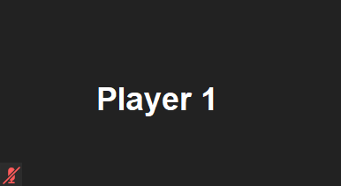
Day 1:
0:00 to vote
Player 1
Player 2
Player 3
Voting has ended.
Player 1 was eliminated.
…they were not a mafia member.
X
Player 4
Player 5
Player 6
Player 7
Player 8
Player 9
Player 10
Player 11
Player 12
Player 13
Player 14
Player 15
Vote

Slide 13
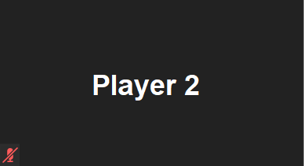
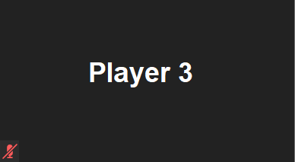
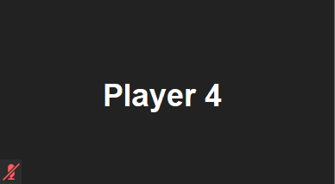
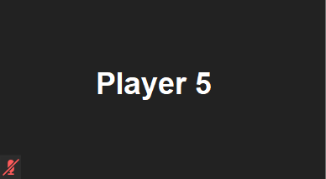

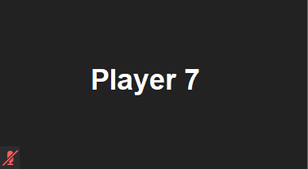
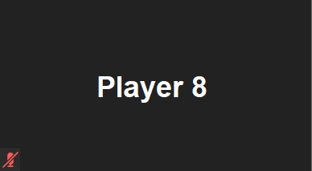
Night 1:
0:30 until day
Player 6
Player 9
Player 10
Player 11
Player 12
Player 13
Player 14
Player 15
Vote

Slide 14
Night 1:
0:29 until day
The night phase begins!
You have 30 seconds to talk with the other Mafia members about who to eliminate.
(Only Mafia members can hear you)
X
Player 6
Player 9
Player 10
Player 11
Player 12
Player 13
Player 14
Player 15
Vote

Slide 15
Night 1:
0:28 until day
Player 6
Player 9
Player 10
Player 11
Player 12
Player 13
Player 14
Player 15
Vote

Slide 16
Night 1:
0:28 until day
Who would you like to eliminate?
Player 1
Player 2
Player 3
Player 4
Player 5
Player 6
Player 7
Player 8
Player 9
Player 10
Player 11
Player 12
Player 6
X
Player 9
Player 10
Player 11
Player 12
Player 13
Player 14
Player 15
Vote

Slide 17
Night 1:
0:02 until day
Player 6
Player 9
Player 10
Player 11
Player 12
Player 13
Player 14
Player 15
Vote

Slide 18
Night 1:
0:01 until day
Player 6
Player 9
Player 10
Player 11
Player 12
Player 13
Player 14
Player 15
Vote

Slide 19
Night 1:
0:00 until day
Player 6
Player 9
Player 10
Player 11
Player 12
Player 13
Player 14
Player 15
Vote

Slide 20
Day 2:
2:00 to vote
Player 1
Player 2
Player 3
During the night,
Player 8 was eliminated.
(13 players remaining)
X
Player 4
Player 5
Player 6
Player 7
Player 8
Player 9
Player 10
Player 11
Player 12
Player 13
Player 14
Player 15
Vote

Slide 21
Day 2:
1:59 to vote
Player 1
Player 2
Player 3
X
Player 4
Player 5
Player 6
Player 7
Player 8
Player 9
Player 10
Player 11
Player 12
Player 13
Player 14
Player 15
Vote

Slide 22
Day 2:
1:58 to vote
Player 1
Player 2
Player 3
This is the end of the prototype.
Thanks for playing!
X
X
Player 4
Player 5
Player 6
Player 7
Player 8
Player 9
Player 10
Player 11
Player 12
Player 13
Player 14
Player 15
Vote

